Slide 1
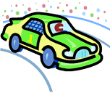
Smart Overtaking Bot
Group 9
Saurabh Bhola, 09005022
Kanwal Prakash Singh, 09005031
Abhishek Kabra, 09005037
Kapil Dubey, 09005038

Slide 2
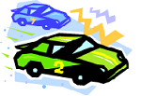
Components of our Project
Vehicle-Bot
A bot that is assumed to be moving at constant speed on the given path
I-Bot
A bot that senses a vehicle-bot in front of it, analyzes its speed, the distance between the vehicle-bot and itself and then overtakes it based upon the calculation it performs

Slide 3
Idea (….in simple words)
The main idea is to build a close to real world situation where vehicles with higher speeds can safely overtake the vehicles moving ahead of them with lower speeds. The overtaking vehicle is the I-Bot and the vehicles that come on its way (with lesser and constant speed) are vehicle bots

Slide 4
Initial efforts…
Cruise Control: Allows driver to set a driving speed
Adaptive Cruise Control: Vehicle is capable of following a leading car by autonomous action on throttle and brake panels
What next??

Slide 5
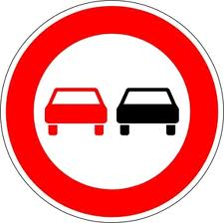
Overtaking Maneuver
A driving action involving a rapid and ‘intelligent’ movement to negotiate an obstacle
It includes movement of steering wheel (path change) and speed increase
But overtaking errors resulting from failure to accurately and timely interpret information about other vehicles in close proximity may result in catastrophic accidents

Slide 6
How to avoid collisions?
Intelligent algorithms addressing following real time issues need to be incorporated:
Calculating proximity to other vehicles
Determine when the lane change maneuver should start (most research in this field has been on lane following)
Developing optimal and safe trajectories

Slide 7
Key Challenges
The biggest challenge is to safely overtake the vehicles taking optimum path
Other challenges include:
Estimation of speed of Vehicle Bot as well as an estimation of the acceleration needed for I-Bot using the sensors
Deciding on the optimal path
Safely regaining the path back sensing a vehicle(s), if any, in its vicinity

Slide 8
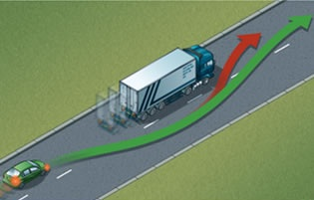
contd…
All the above challenges (trajectory planning) should be addressed in the absence as well as presence of vehicles in the passing lane.
Also, a safety distance should be ensured between the vehicles in order to avoid any collision

Slide 9
Let’s Plan!
The coding work was divided into writing code for ACC, including overtaking maneuver, ensuring safe regaining of track, including code for Xbee in Matlab for image processing.
The documentation involved making SRS, Presentations, documenting the code for ensuring readability
The testing involved various scenarios as will be described later

Slide 10
Addressing the challenges
The bots move in an arena with three white lines – the underlying reason being use of white line sensors for the movement of the bots.
The tracks are curved and make three parallel loops (to avoid the limitation of straight-line overtaking reaching an end)
Is three track idea a good choice?

Slide 11
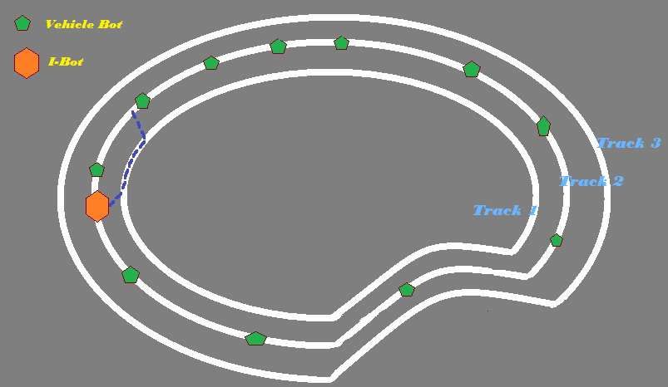

Slide 12
The Three Parallel Tracks
It is based on our idea of choosing the shorter path while overtaking over a curve as we know the smaller the radius of curvature of the overtaking path the smaller would be the path to traverse while overtaking.
But this also adds to the complexity involved in keeping control on the speed of the bot over the curved path, when the bot has to constantly monitor its own path so that it doesn't lose its track while overtaking.
All the bots shall move in the middle track in the initial situation in unidirectional manner with I-Bot following the Vehicle-Bots.

Slide 13
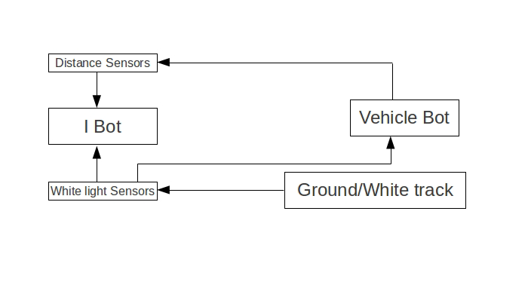
Work Flow Diagram

Slide 14
Is it too simple?
Further complexities involve having a number of vehicle-bots on the middle track, as well as on the overtaking tracks – to check how safely can our I-bot overtake
Adding more complexity, we have the speeds of the vehicle bots varying, that makes situation even difficult for a safe overtaking as the vehicle bot might increase its speed while the I-bot is overtaking and regaining its path back which might lead to an accident

Slide 15
Raising the bar – reaching it!
A large number of obstacles (due to spark bots not functioning well) were introduced in the three tracks which are sensed by the camera installed on our I-Bot and hence it behaves accordingly
It detects a bot/obstacle through the camera as well as sensors and tries to overtake it safely.
In case a bot is moving in opposite direction in the overtaking path, it stops following Adaptive Cruise Control

Slide 16
Contd….
For accommodating the added feature of varying speeds of vehicle bots, it has left and right sharp sensors, giving it instructions regarding presence of any vehicle in their respective sides so that it does not overtake until one of the paths, preferably optimal, is free and also safely regains back its original path

Slide 17
Problems Faced
Firebird didn’t work perfectly many times leading to re-running the code everytime for better results
There were issues like Firebird losing its track despite correct code – the problem was deduced to be with the sensors and sometimes with the reflection of light on shiny black surface
The results came out to be better with more number of run throughs

Slide 18
Two Scenarios - 1
1) Simple Overtaking Scenario
I-Bot travelling with velocity V pursuing vehicle bot with a slower velocity W
Overtaking Manoeuvre:
1) Move from driving lane to passing lane
2) Travel in passing lane till you overtake
3) Return to the driving lane

Slide 19
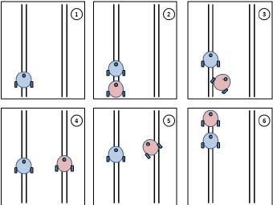
Two Scenarios - 1

Slide 20
Two Scenarios - 2
2) In presence of another vehicle bots in the passing lane, and bots with varying speed
Every situation and the strategy involved while overtaking in it is well explained in the figure on next slide

Slide 21
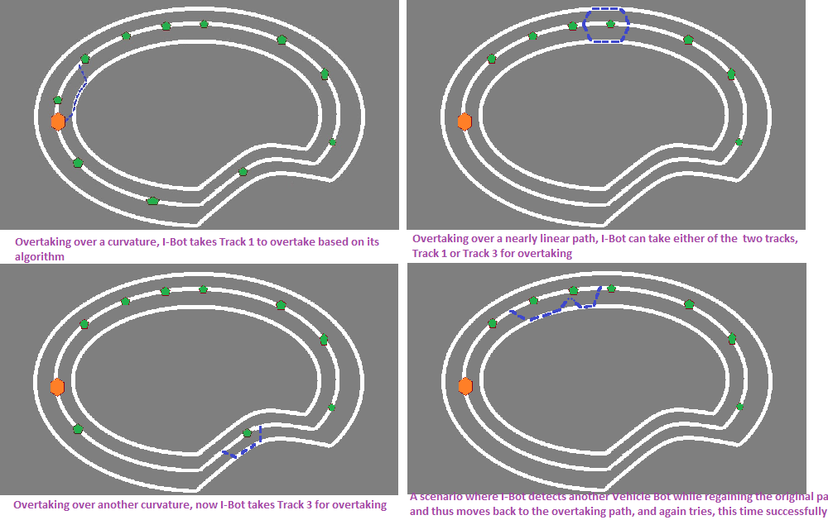

Slide 22
Performance Metrics
While testing, if the bot doesn’t work in desired way, firstly check for the sensor values that should be as expected on a white/black surface
Also use sharp sensors for better results while safe overtaking
The Bot takes the optimum of the two paths available for overtaking

Slide 23
Unique Selling Points
It is in close proximity with the real life situation of traffic on roads, where there are a lot if vehicles moving in a single lane, with no vehicle moving at constant speed and also, continuous overtaking between vehicles
It is built upon the idea of Cruise Control and ACC which are too ideal to be implemented in real life
It not only allows overtaking but also has major focus on SAFE OVERTAKING

Slide 24
Unique Selling Points
It prevents all kinds of accidents that might happen due to heavy traffic in the original as well as adjacent lanes, and varying speed of the vehicle being overtaken
Some projects that can be built upon our idea:
Smart Race: A race of overtaking bots taking optimum paths (following algorithms) while overtaking
E-Coolie: A coolie that follows its master in a crowd, just like a human
Thief Catching Cars for Police

Slide 25
Unique Selling Points
The Image Processing components and the algorithms involved can be made better in future projects
Summarizing, we can say it is a good start for a mega project ( A legacy for future)
“While it is well enough to leave footprints on the sands of time, it is even more important to make sure they point in a commendable direction.”
- James Cabell

Slide 26
Re-usability of Code
The Codes – Smart_Overtaking_Bot.c, lcd.c, and matlabgrp9.m - for overtaking, safely regaining of path and Image Processing for vehicle detection can be re-used and enhanced as said earlier too.
Apart from Firebird, the Spark Bots and their ACC codes would also work for adding traffic

Slide 27
Where can we fail?
When there is a clump of vehicle bots and no possibility for I-Bot to move in either lane, hence it should take precaution and slow down to the speed of the vehicle ahead
When the path are too curved, and hence keeping the bots following white line becomes too difficult
Figure on the next page

Slide 28
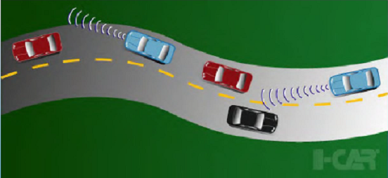
Situation of failure:

Slide 29
Hardware needed
Pursuer and Obstacle vehicles ( I-Bot and Vehicle Bots respectively)
CCD Camera
Floor Workspace
Sharp Sensors

Slide 30
Thank You

